Slide 1
CORE JAVA
AMOL R PATIL - 9822291613NE

Slide 2
What is Object Oriented Programming ?
Object-oriented programming (OOP) is a computer programming model that organizes software design around data, or objects, rather than functions and logic.
An object can be defined as a data field that has unique attributes and behavior
Everything’s an object, right? Well, almost everything. The assertion that everything is an object is the concept which underlies object-oriented programming, or OOP for short.

Slide 3
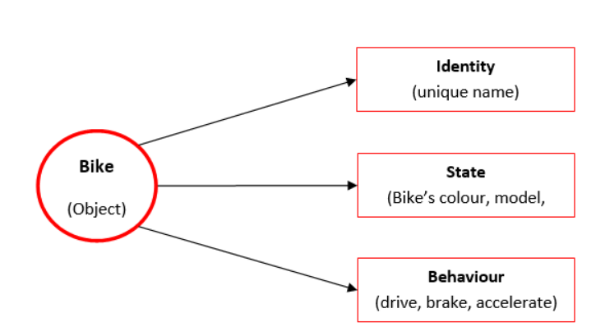
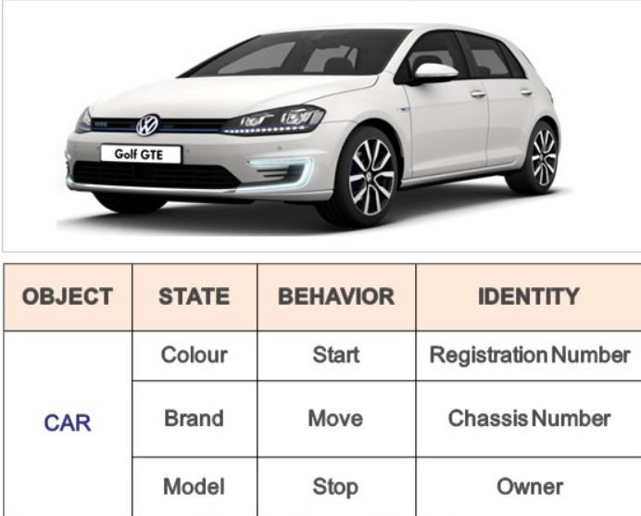
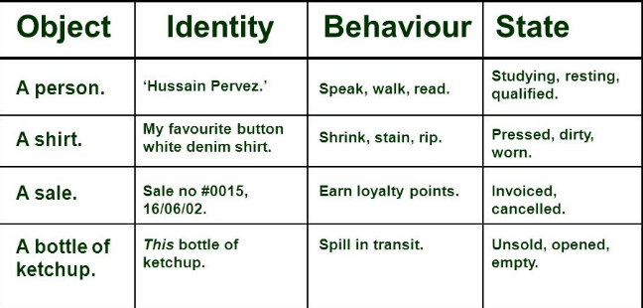
Characteristics of an OBJECT

Slide 4
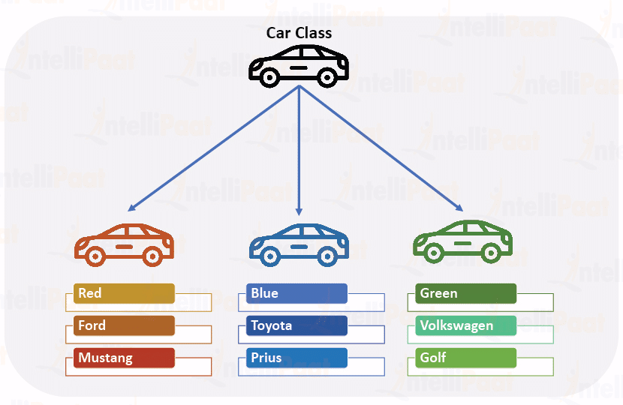
Class and Objects
Class: Think of a class like a blueprint or a template. It defines the structure and behavior of something. For example, a "Car" class could define what properties (like color and model) a car has and what actions (like starting the engine) it can do. It's a general plan.
Object: An object is like a specific instance created from that blueprint. If the "Car" class is the blueprint, an object would be an actual car, like a red Toyota. Objects are like real, usable things that follow the instructions laid out in the class.
So, a class is a plan, and an object is something built based on that plan. Think of a class as a recipe, and an object as the actual dish you cook using that recipe.

Slide 5
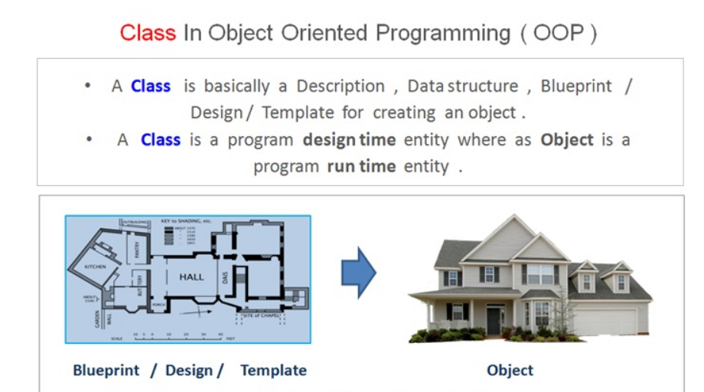

Slide 6
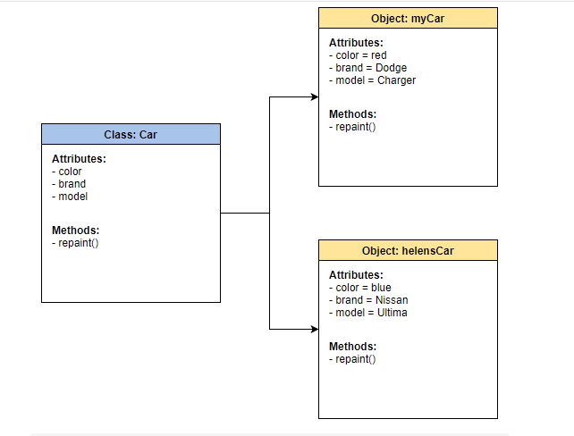

Slide 7
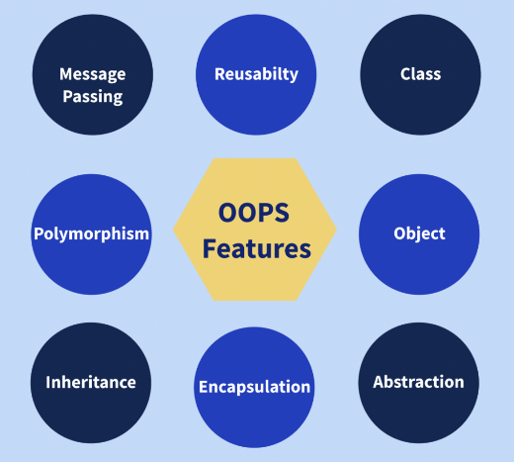
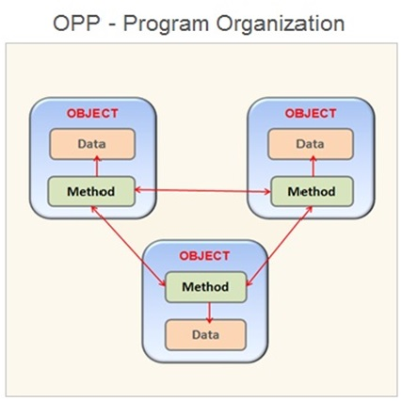

Slide 8
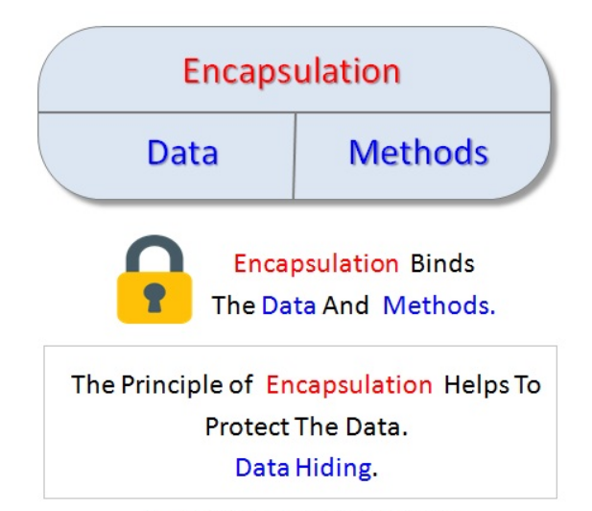
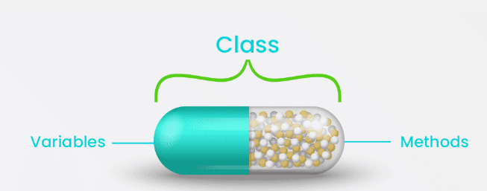
Encapsulation

Slide 9
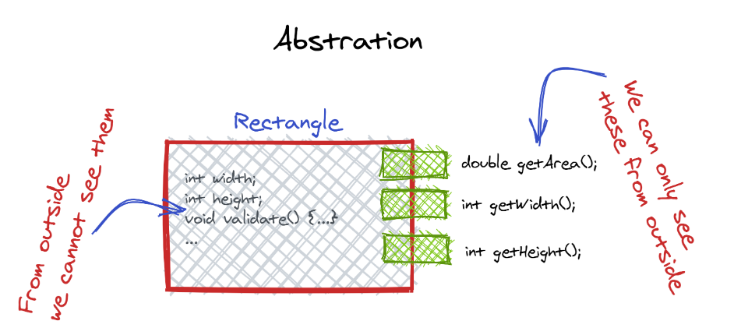
Abstraction

Slide 10
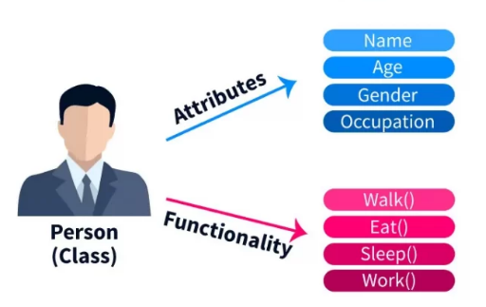
Java class
Class is a blueprint or a set of instructions to build a specific type of object. It is a basic concept of Object-Oriented Programming which revolve around the real-life entities. Class in Java determines how an object will behave and what the object will contain.

Slide 11
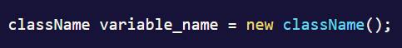
Java object
Object is an instance of a class. An object in OOPS is nothing but a self-contained component which consists of methods and properties to make a particular type of data useful. For example color name, table, bag, barking. When you send a message to an object, you are asking the object to invoke or execute one of its methods as defined in the class.
From a programming point of view, an object in OOPS can include a data structure, a variable, or a function. It has a memory location allocated. Java Objects are designed as class hierarchies.

Slide 12
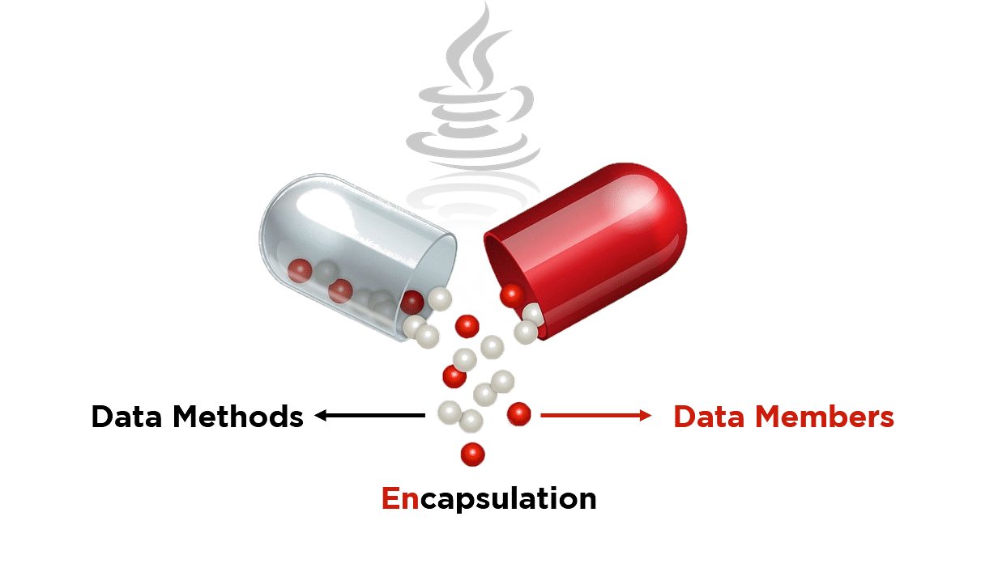
Encapsulation in Java

Slide 13
Java Access Specifiers
Access Specifier | Inside Class | Inside Package | Outside package subclass | Outside package
Private | Yes | No | No | No
Default | Yes | Yes | No | No
Protected | Yes | Yes | Yes | No
Public | Yes | Yes | Yes | Yes

Slide 14
Message Passing
A request for an object to perform one of its operations is called a message.
Operation means method/function. A message cannot go automatically it creates an interface, which means it creates an interface for an object. The interface provides the abstraction over the message means hide the implementation.
An interface is a set of operations that a given object can perform.
All communication between objects is done via message is called message passing,

Slide 15
Constructors
A constructor is a special method of a class or structure in object-oriented programming that initializes a newly created object of that type.
Whenever an object is created, the constructor is called automatically.
Constructors are not called explicitly and are invoked only once during their lifetime

Slide 16
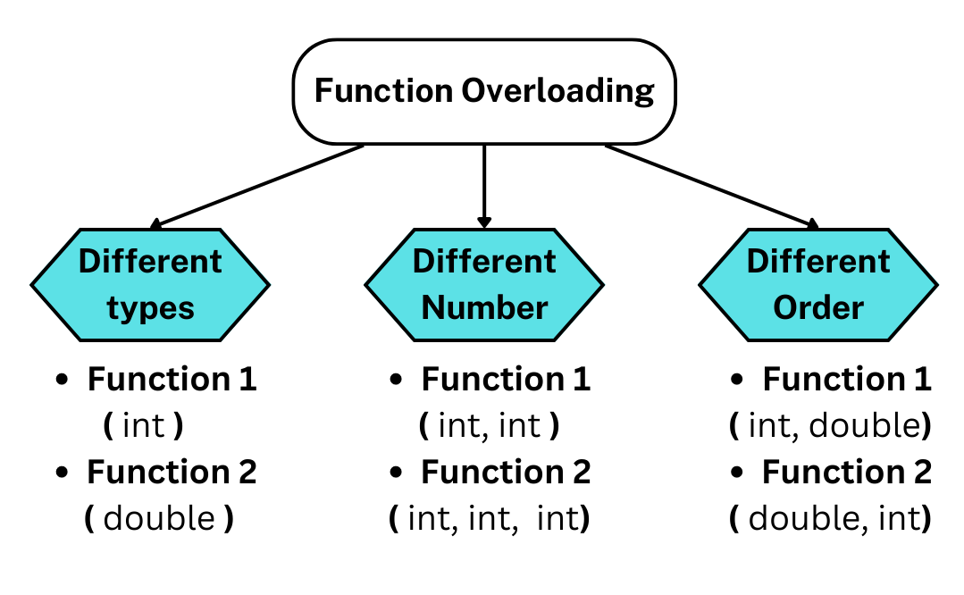
Function Overloading
Java lets you specify more than one function of the same name in the same scope. These functions are called overloaded functions, or overloads. Overloaded functions enable you to supply different semantics for a function, depending on the types and number of its arguments.

Slide 17
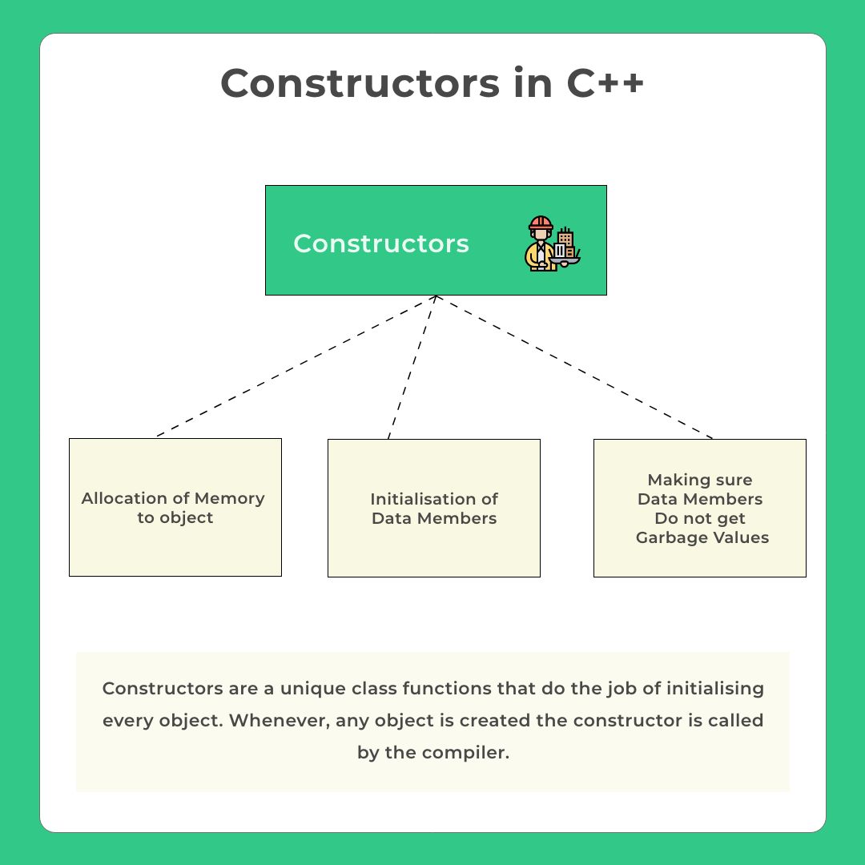

Slide 18
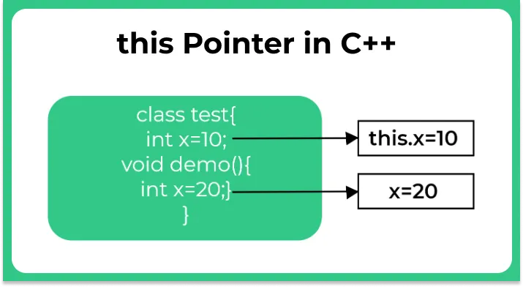
this Pointer
In Java programming, this is a keyword that refers to the current instance of the class

Slide 19
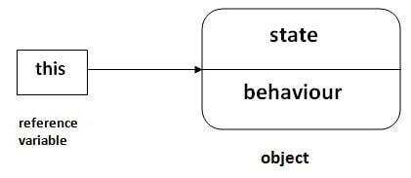
this keyword in Java
this can be used to refer current class instance variable.
this can be used to invoke current class method (implicitly)
this() can be used to invoke current class constructor.
this can be passed as an argument in the method call.
this can be passed as argument in the constructor call.
this can be used to return the current class instance from the method.

Slide 20
Forms of Relationships
There are main forms of relationships in OOP paradigm.
IS-A (Inheritance) HAS-A (Association)
IS-A Relationship Car IS A Vehicle Cat IS AN Animal Manager IS AN Employee
All these examples denote that sub type is in the form of super type creating is-a relationship.
HAS-A Relationship Hotel HAS Rooms School HAS Departments Employee HAS Address
This represents the ownership of an entity in another. One entity belongs to another…
There are 2️⃣ forms of Association that are possible in Java:
a) Aggregation — loose coupling, weak
b) Composition — tight coupling, strong

Slide 21
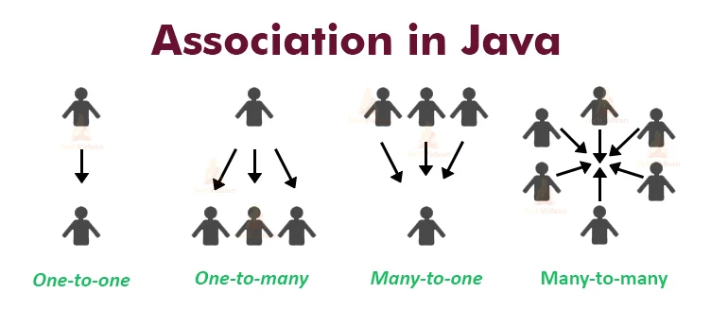
Association
Association is a relation between two separate classes which establishes through their Objects

Slide 22
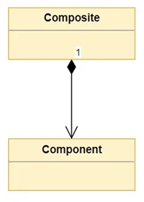
Composition
The composition means having a container object that contains other objects.
Composition is a concept that models a has a relationship. This means that a class Composite can contain an object of another class Component. This relationship means that a Composite has a Component.
Classes that contain objects of other classes are usually referred to as composites, where classes that are used to create more complex types are referred to as components

Slide 23
Aggregation
Aggregation is an association that describes “has a” relationship between objects. For example, a classroom and student are linked with “has a” relationship
Difference Between Composition & Aggregation :-
Aggregation is an association between two objects which describes the “has a” relationship while the composition is the most specific type of aggregation that implies ownership. Thus, this is the main difference between aggregation and composition.
In aggregation, destroying the owning object does not affect the containing object. However, in composition, destroying the owning object affects the containing object. Hence, this is another difference between aggregation and composition.

Slide 24
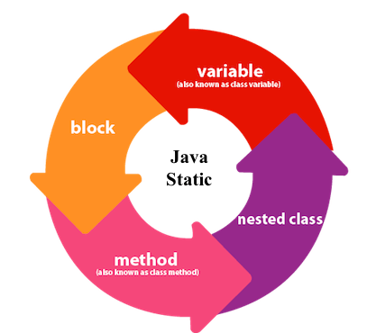
Java static members

Slide 25
static variables
Static variables defined as a class member can be accessed without object of that class. Static variable is initialized once and shared among different objects of the class. All the object of the class having static variable will have the same instance of static variable.
Static variable | Instance Variable
Represent common property | Represent unique property
Accessed using class name (can be accessed using object name as well) | Accessed using object
Allocated memory only once | Allocated new memory each time a new object is created

Slide 26
Java static method
If you apply static keyword with any method, it is known as static method.
A static method belongs to the class rather than the object of a class.
A static method can be invoked without the need for creating an instance of a class.
A static method can access static data member and can change the value of it.
Static block in Java
Static block is used to initialize static data members. Static block executes even before main() method.
It executes when the class is loaded in the memory.
A class can have multiple Static blocks, which will execute in the same sequence in which they are programmed

Slide 27
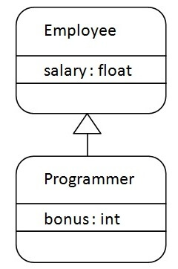
Inheritance in Java
Inheritance in Java is a mechanism in which one object acquires all the properties and behaviors of a parent object. It is an important part of OOPs (Object Oriented programming system).
The idea behind inheritance in Java is that you can create new classes that are built upon existing classes. When you inherit from an existing class, you can reuse methods and fields of the parent class. Moreover, you can add new methods and fields in your current class also.
Inheritance represents the IS-A relationship which is also known as a
parent-child relationship.

Slide 28
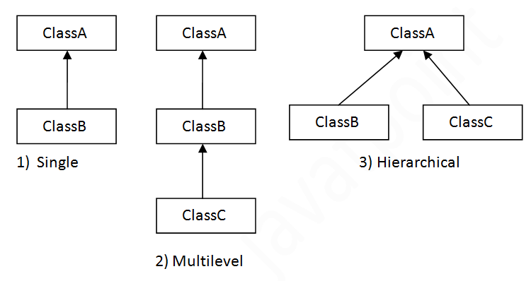
Types of Inheritances

Slide 29
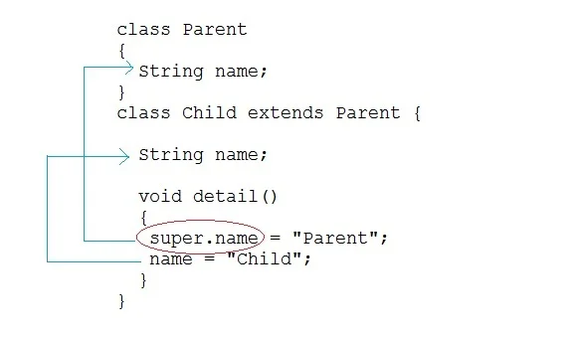
super keyword
In Java, super keyword is used to refer to immediate parent class of a child class. In other words, super keyword is used by a subclass whenever it need to refer to its immediate super class.

Slide 30
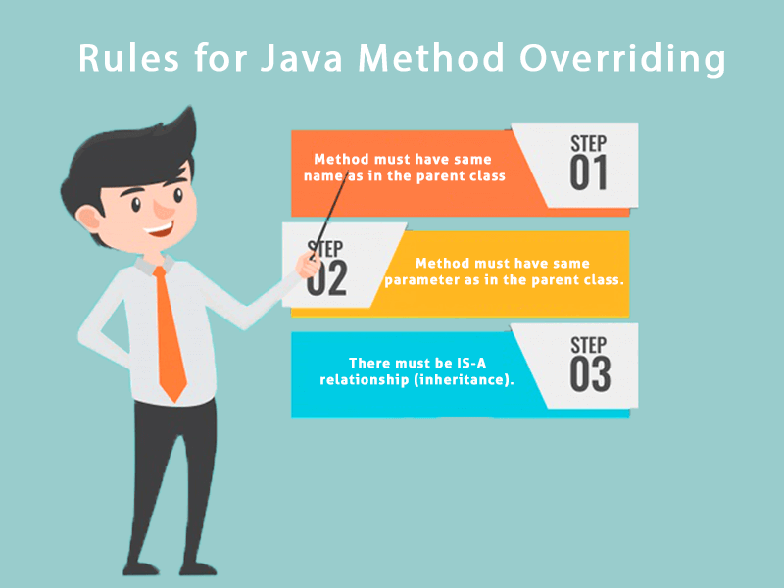
Method Overriding
If subclass (child class) has the same method as declared in the parent class, it is known as method overriding in Java.

Slide 31
Method Overriding
When we override a method, it's recommended to put @Override, immediately above the method definition.
The @Override statement is not required, but it's a way to get the compiler to flag an error, if you don't actually properly override this method.
We'll get an error, if we don't follow the overriding rules correctly.
We can't override static methods, only instance methods can be overridden

Slide 32
Method Overriding Rules
A method will be considered overridden, if we follow these rules.
It must have the same name and same arguments.
The return type can be a subclass of the return type in the parent class.
It can't have a lower access modifier. In other words, it can't have more restrictive access privileges.
For example, if the parent's method is protected, then using private in the child's overridden method is not allowed. However, using public for the child's method would be allowed, in this example.

Slide 33
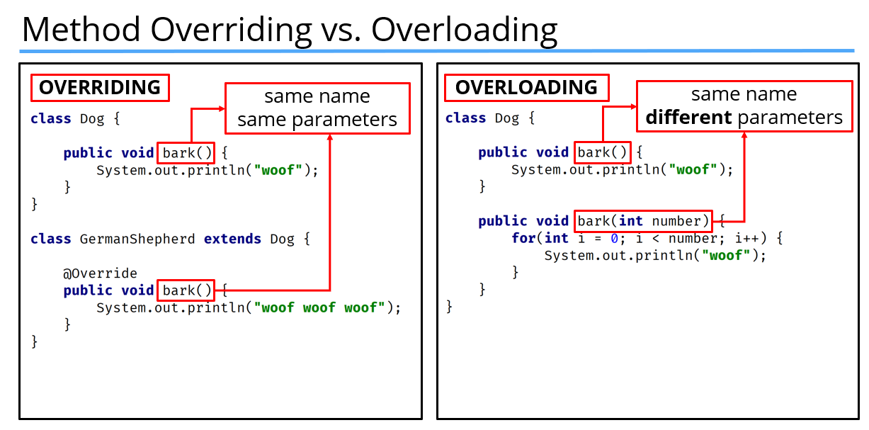

Slide 34
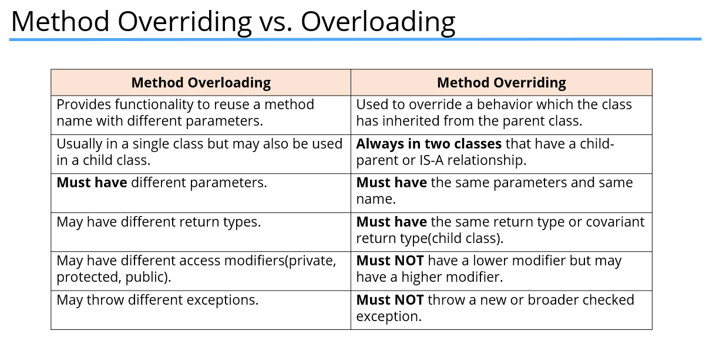

Slide 35
final modifier
Final modifier is used to declare a field as final. It can be used with variable, method or a class.
If we declare a variable as final, then it prevents its content from being modified. The variable acts like a constant. Final field must be initialized when it is declared. Final variable that is not initialized at the time of declaration is called blank final variable. Java allows to declare a final variable without initialization, but it should be initialized by the constructor only
If we declare a method as final, then it prevents it from being overridden.
If we declare a class as final the it prevents from being inherited. We can not inherit final class in Java.

Slide 36
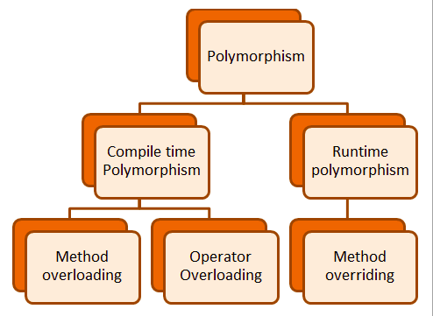

Slide 37
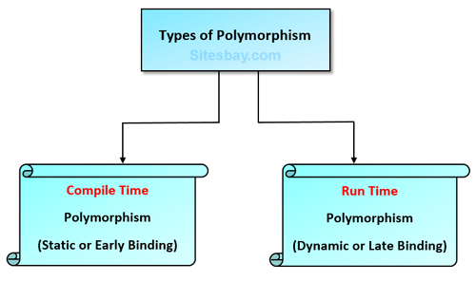

Slide 38
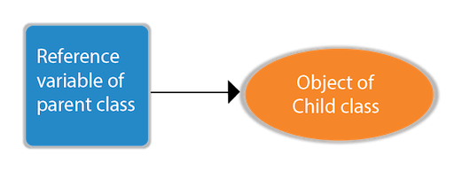
Dynamic Polymorphism
Runtime polymorphism or Dynamic Method Dispatch is a process in which a call to an overridden method is resolved at runtime rather than compile-time.

Slide 39
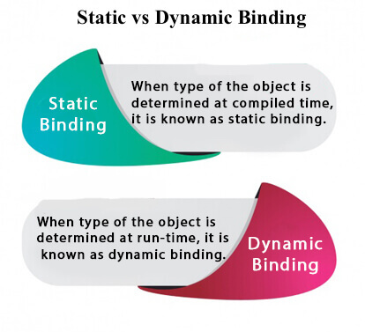
static binding and dynamic binding
Connecting a method call to the method body is known as binding.
There are two types of binding
Static Binding (also known as Early Binding).
Dynamic Binding (also known as Late Binding).

Slide 40
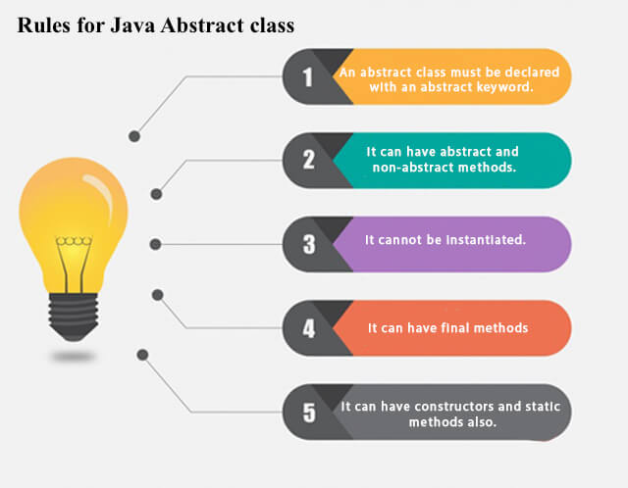
Abstract class
Abstraction is a process of hiding the implementation details and showing only functionality to the user.
A class which is declared using abstract keyword known as abstract class. An abstract class may or may not have abstract methods. We cannot create object of abstract class.

Slide 41
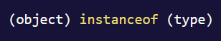
instance of operator
In Java, instanceof is an operator which is used to check object reference. It checks whether the reference of an object belongs to the provided type or not. It returns either true or false, if an object reference is of specified type, then it return true otherwise false.

Slide 42
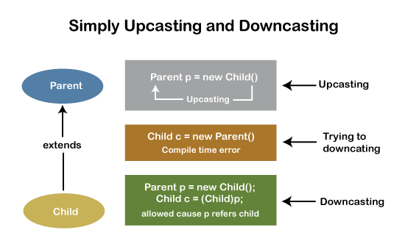
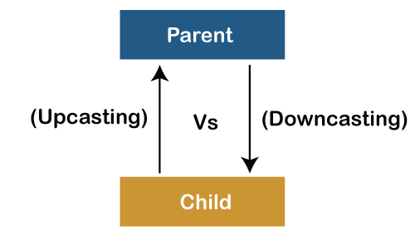
Downcasting and Upcasting

Slide 43
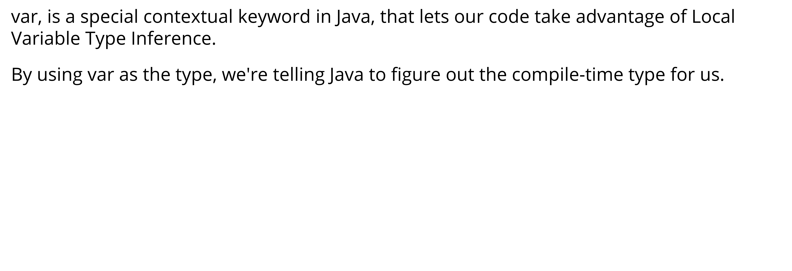
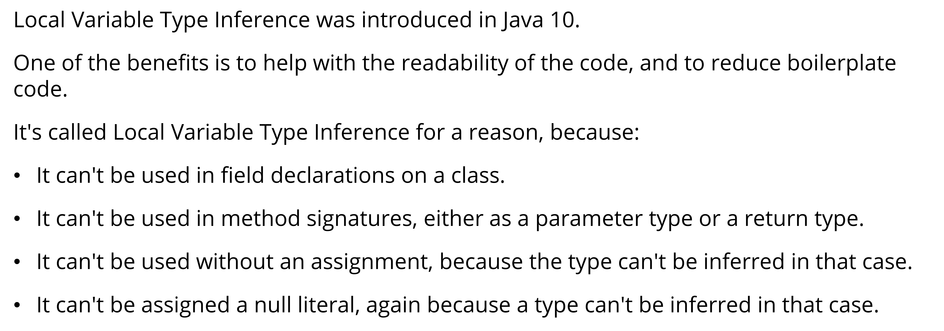
var type

Slide 44
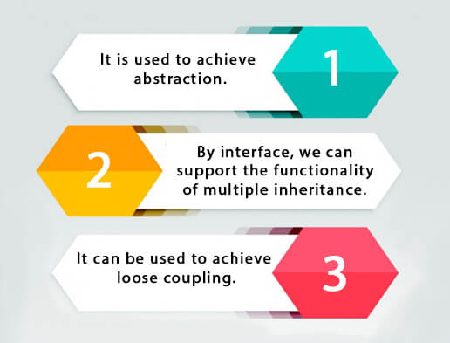
Java Interfaces
An interface in Java is a blueprint of a class. It has static constants and abstract methods.
The interface in Java is a mechanism to achieve abstraction. There can be only abstract methods in the Java interface, not method body. It is used to achieve abstraction and multiple inheritance in Java.
Since Java 8, we can have default and static methods in an interface.
Since Java 9, we can have private methods in an interface.

Slide 45
Purpose of Java Interfaces
An interface in Java is a specification of method prototypes. Whenever you need to guide the programmer or, make a contract specifying how the methods and fields of a type should be you can define an interface
Multiple inheritance − Java doesn’t support multiple inheritance, using interfaces you can achieve multiple inheritance −
Abstraction − Abstraction is a process of hiding the implementation details from the user, only the functionality will be provided to the user. In other words, the user will have the information on what the object does instead of how it does it.
Since all the methods of the interface are abstract and user doesn’t know how a method is written except the method signature/prototype. Using interfaces, you can achieve (complete) abstraction.
Loose coupling − Coupling refers to the dependency of one object type on another, if two objects are completely independent of each other and the changes done in one doesn’t affect the other both are said to be loosely coupled.
You can achieve loose coupling in Java using interfaces −

Slide 46
Default Methods in Interface
With the release of Java 8, we can now add methods with implementation inside an interface. These methods are called default methods.
public default void getSides() {
// body of getSides()
}
The Java 8 also added another feature to include static methods inside an interface.
With the release of Java 9, private methods are also supported in interfaces. private methods are used as helper methods that provide support to other methods in interfaces.

Slide 47
Functional Interface
An Interface that contains exactly one abstract method is known as functional interface. It can have any number of default, static methods but can contain only one abstract method.
Functional Interface is also known as Single Abstract Method Interfaces or SAM Interfaces
Runnable, ActionListener, and Comparable are some of the examples of functional interfaces.
Functional interfaces are used and executed by representing the interface with an annotation called @FunctionalInterface.

Slide 48
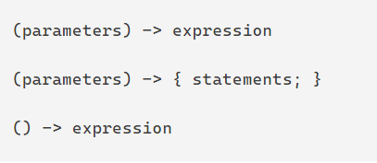
Lambda Expression
Lambda Expression is an anonymous (nameless) function. In other words, the function which doesn’t have the name, return type and access modifiers. Lambda Expression is also known as anonymous functions or closures.
The primary Objective of introducing Lambda Expression is to promote the benefits of functional programming in Java

Slide 49
Abstract class vs. Interface
Abstract class | Interface
Abstract class is a class which contain one or more abstract methods, which has to be implemented by its sub classes. | Interface is a Java Object containing method declaration but no implementation. The classes which implement the Interfaces must provide the method definition for all the methods.
Abstract class is a Class prefix with an abstract keyword followed by Class definition. | Interface is a pure abstract class which starts with interface keyword.
Abstract class can also contain concrete methods. | Whereas, Interface contains all abstract methods and final variable declarations.
Abstract classes are useful in a situation that Some general methods should be implemented and specialization behavior should be implemented by child classes. | Interfaces are useful in a situation that all properties should be implemented.

Slide 50
Nested classes
Java inner class or nested class is a class that is declared inside the class or interface.
We use inner classes to logically group classes and interfaces in one place to be more readable and maintainable.
Additionally, it can access all the members of the outer class, including private data members and methods.
There are two types of nested classes you can create in Java.
Non-static nested class (inner class)
Static nested class

Slide 51
Nested classes
Type | Description
Member Inner Class | A class created within class and outside method.
Anonymous Inner Class | A class created for implementing an interface or extending class. The java compiler decides its name.
Local Inner Class | A class was created within the method.
Static Nested Class | A static class was created within the class.
Nested Interface | An interface created within class or interface.

Slide 52
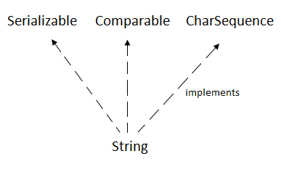
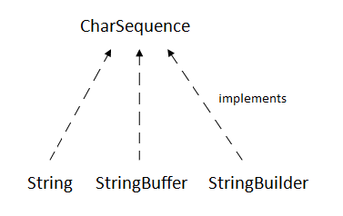
Java Strings
String is Sequence of Characters represented as an Object
The Java String is immutable which means it cannot be changed. Whenever we change any string, a new instance is created.
For mutable strings, you can use StringBuffer and StringBuilder classes.

Slide 53
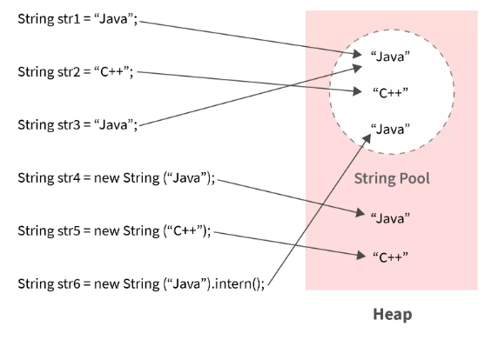
String Pool
All Strings are stored in the String Pool (or String Intern Pool) that is allocated in the Java heap.
String pool is an implementation of the String Interring Concept.
String Interning is a method that stores only a copy of each distinct string literal.
The distinct values are stored in the String pool.
String pool is an example of the Flyweight Design Pattern

Slide 54
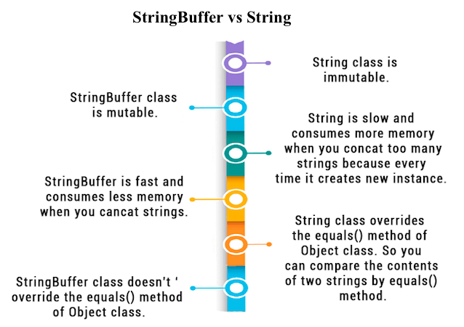

Slide 55
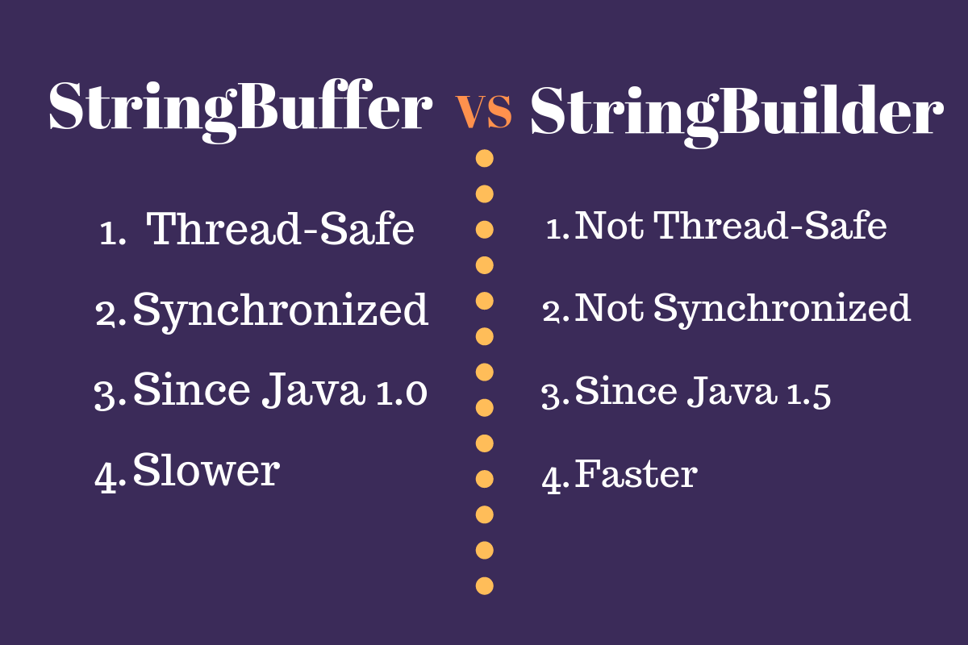

Slide 56
Java Object class
The Object class is the parent class of all the classes in java by default. In other words, it is the topmost class of java.
Java Object getClass() returns the class name of the object
Java Object hashCode() returns the hashcode value of the object
Java Object toString() converts an object into the string
Java Object equals() checks if two objects are equal
Java Object clone() creates a copy of the object

Slide 57
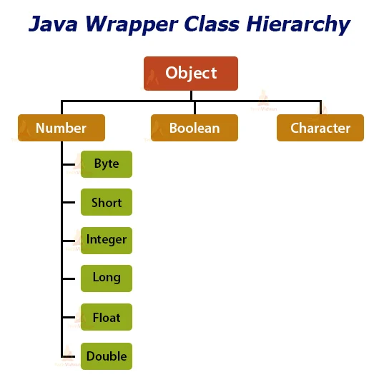
Java Wrapper Classes

Slide 58
Java Exception
An expectation is an unexpected event that occurs while executing the program, that disturbs the normal flow of the code
. It can occur for various reasons say-
A user has entered an invalid data
File not found
A network connection has been lost in the middle of communications
The JVM has run out of a memory

Slide 59
Exception Handling
The Exception Handling in Java is a mechanism using which the normal flow of the application is maintained. To do this, we employ a powerful mechanism to handle runtime errors or exceptions in a program.
Java exception handling provides a meaningful message to the user about the issue rather than a system generated message, which may not be understandable to a user

Slide 60
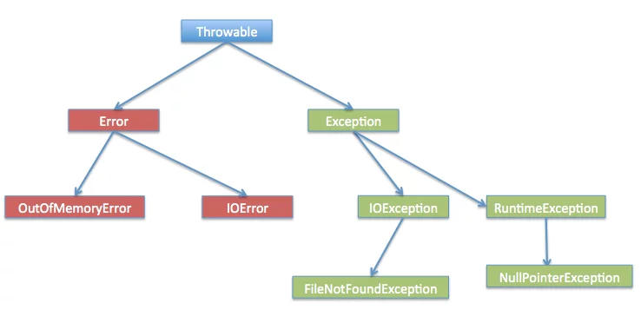
Exception Hierarchy

Slide 61
Types of Exceptions
Checked Exception
These are the exceptions that are checked at compile time. If some code within a method throws a checked exception, then the method must either handle the exception or it must specify the exception using the throws keyword.
Unchecked Exception
These are the exceptions that are not checked at compile time.

Slide 62
Program on Loops
Count of prime no’s in given range
2. WAP to generate the max number using the digits of entered number
4936 --> 9643
3. Enter the number and add the alternate digit from it.
no=28416 ==> 6+4+2 = 12
1+8 = 9
4. Write a program to print the Floyd's Triangle.
1
01
101
0101
10101

Slide 63
Program on Arrays
1. Write a program to find second largest element in an array.
2. Write a program to count frequency of each element in an array.
3. Write a program to print all unique elements in the array.
4. Write a program to count total number of duplicate elements in an array.

Slide 64
Inheritance
Design and develop inheritance for a given case study, identify objects and relationships
and implement inheritance wherever applicable.
Employee class has Emp_name, Emp_id,
Address, Mail_id, and Mobile_no as members. Inherit the classes: Programmer, Team Lead, Assistant Project Manager and Project Manager from employee class.
Add Basic Pay (BP) as
the member of all the inherited classes . with 97% of BP as DA, 10 % of BP as HRA, 12% of
BP as PF, 0.1% of BP for staff club fund. Generate pay slips for the employees with their
gross and net salary

Slide 65
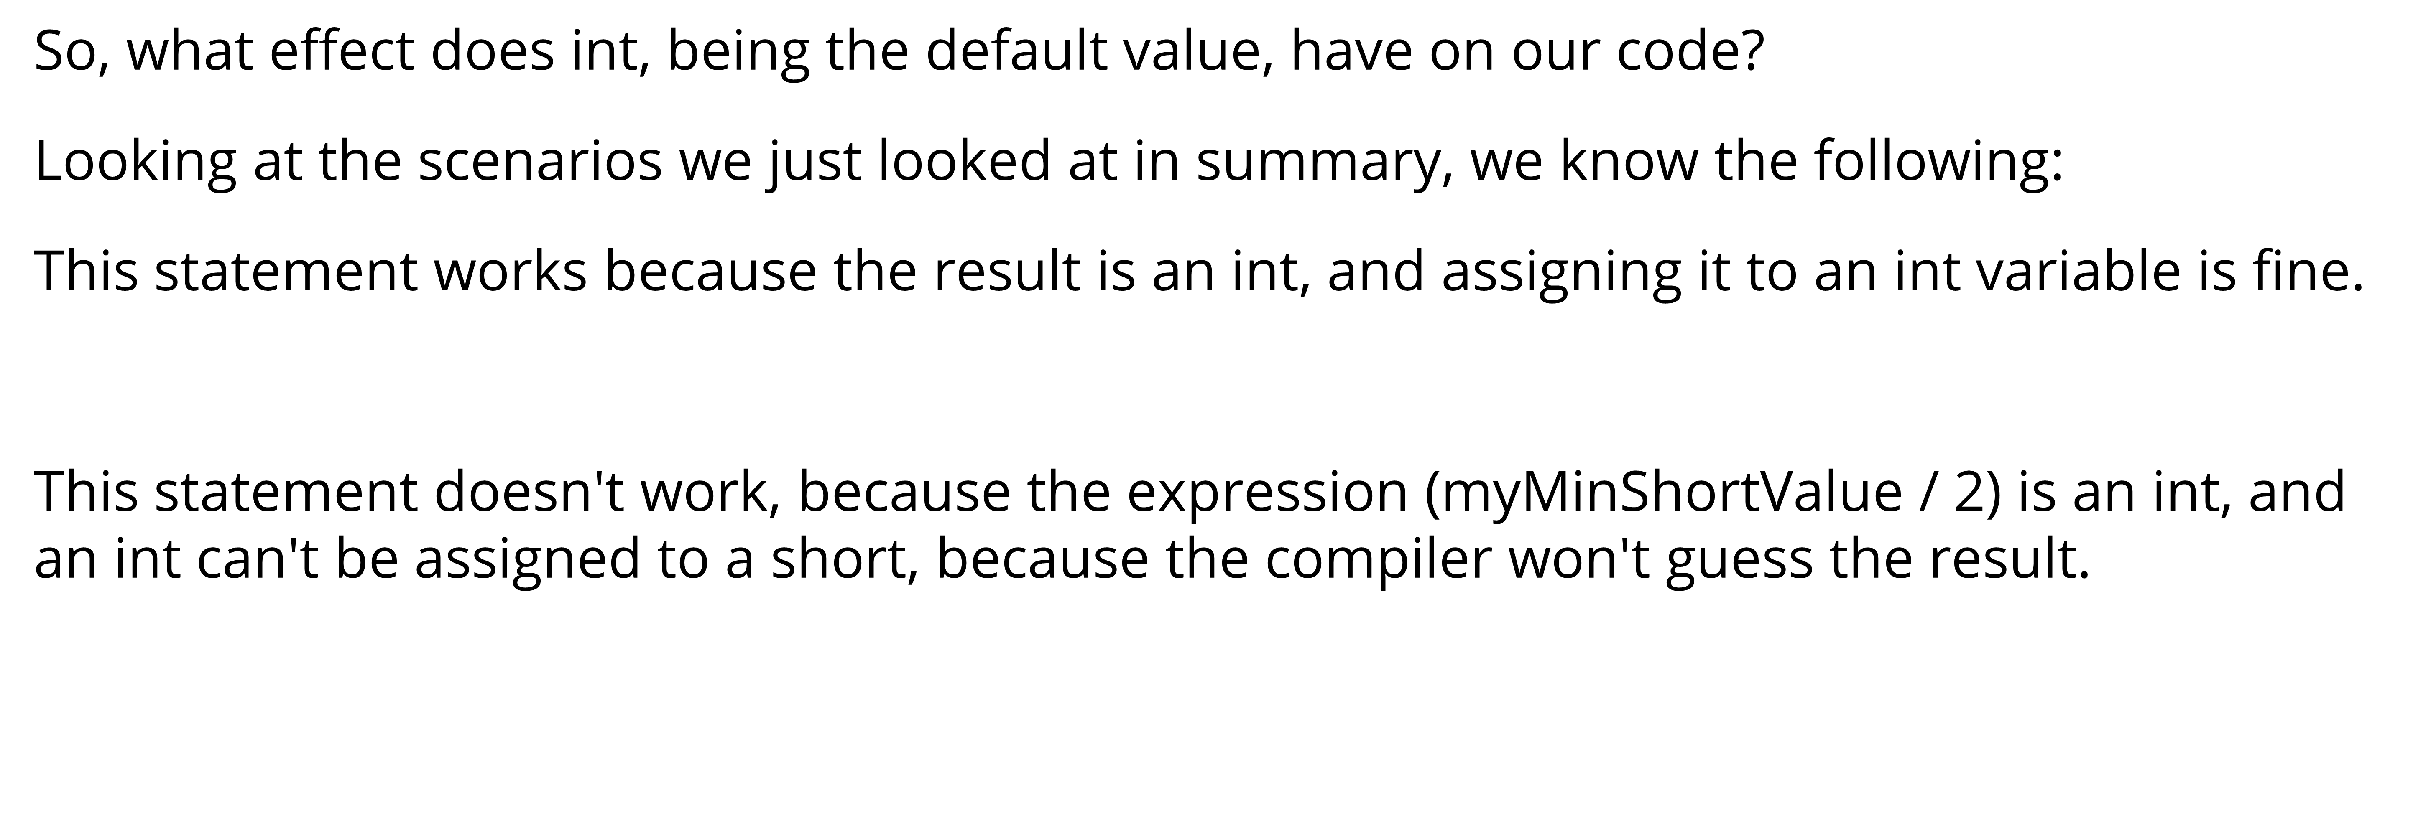

Slide 66
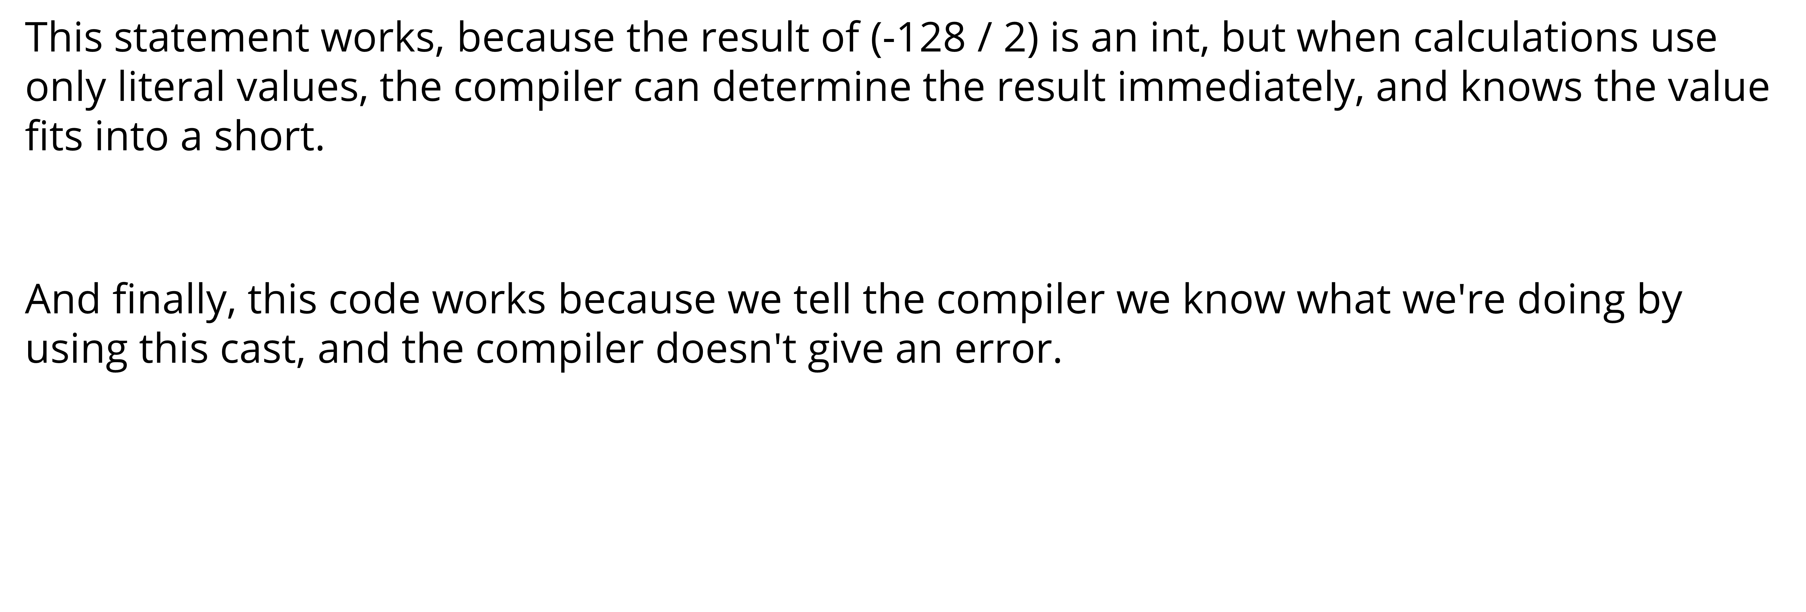

Slide 67
Leap Year Calculator – Method Ex.
Write a method isLeapYear with a parameter of type int named year.
The parameter needs to be greater than or equal to 1 and less than or equal to 9999.
If the parameter is not in that range return false.
Otherwise, if it is in the valid range, calculate if the year is a leap year and return true if it is a leap year, otherwise return false.
To determine whether a year is a leap year, follow these steps:
1. If the year is evenly divisible by 4, go to step 2. Otherwise, go to step 5.
2. If the year is evenly divisible by 100, go to step 3. Otherwise, go to step 4.
3. If the year is evenly divisible by 400, go to step 4. Otherwise, go to step 5.
4. The year is a leap year (it has 366 days). The method isLeapYear needs to return true.
5. The year is not a leap year (it has 365 days). The method isLeapYear needs to return false.
The following years are not leap years:
1700, 1800, 1900, 2100, 2200, 2300, 2500, 2600
This is because they are evenly divisible by 100 but not by 400.

Slide 68
The following years are leap years:
1600, 2000, 2400
This is because they are evenly divisible by both 100 and 400.
Examples of input/output:
isLeapYear(-1600); → should return false since the parameter is not in range (1-9999)
isLeapYear(1600); → should return true since 1600 is a leap year
isLeapYear(2017); → should return false since 2017 is not a leap year
isLeapYear(2000); → should return true because 2000 is a leap year

Slide 69
DecimalComparator Method-Ex
Write a method areEqualByThreeDecimalPlaces with two parameters of type double.
The method should return boolean and it needs to return true if two double numbers are the same up to three decimal places. Otherwise, return false.
EXAMPLES OF INPUT/OUTPUT:
areEqualByThreeDecimalPlaces(-3.1756, -3.175); → should return true since numbers are equal up to 3 decimal places.
areEqualByThreeDecimalPlaces(3.175, 3.176); → should return false since numbers are not equal up to 3 decimal places
areEqualByThreeDecimalPlaces(3.0, 3.0); → should return true since numbers are equal up to 3 decimal places.
areEqualByThreeDecimalPlaces(-3.123, 3.123); → should return false since numbers are not equal up to 3 decimal places.

Slide 70
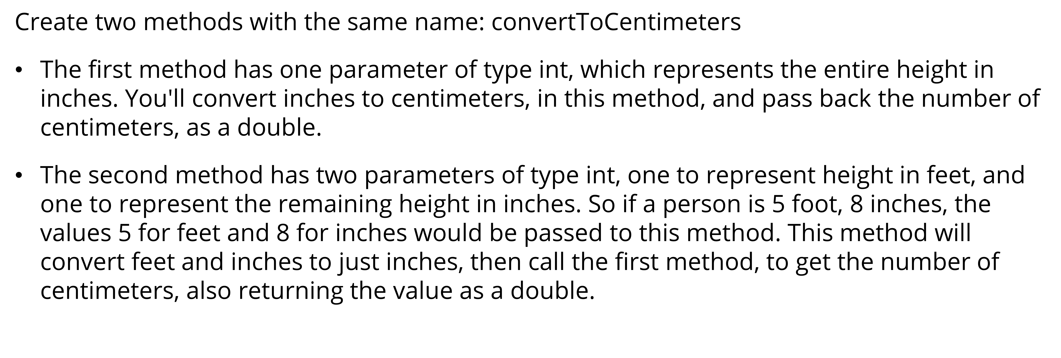

Slide 71
Sum Calculator – class and object ex.
Write a class with the name SimpleCalculator. The class needs two fields (instance variables) with names firstNumber and secondNumber both of type double.
SimpleCalculator calculator = new SimpleCalculator();
calculator.setFirstNumber(5.0);
calculator.setSecondNumber(4);
System.out.println("add= " + calculator.getAdditionResult());
System.out.println("subtract= " + calculator.getSubtractionResult());
calculator.setFirstNumber(5.25);
calculator.setSecondNumber(0);
System.out.println("multiply= " + calculator.getMultiplicationResult());
System.out.println("divide= " + calculator.getDivisionResult());

Slide 72
Rectangle – class and object ex.
Write a class with the name Rectangle. The class needs two fields (instance variables) with names length and width both of type double.
Rectangle r=new Rectangle();
r.setLength(10.5);//check with negative values.
r.setBreadth(5.5);
System.out.println("Area "+r.area());
System.out.println("Perimeter "+r.perimeter());
System.out.println("Is Square "+r.isSquare());
System.out.println("Length "+r.getLength());
System.out.println("Breadth "+r.getBreadth());

Slide 73
Cylinder – class and object ex.
Write a class with the name Cylinder. The class needs two fields (instance variables) with names radius and height both of type double.
Cylinder c=new Cylinder();
c.setHeight(10);
c.setRadius(7);
c.setDimensions(10, 7);
System.out.println("LidArea "+c.lidArea());
System.out.println("Circumference "+c.perimeter());
System.out.println("totalSurfaceArea "+c.drumArea());
System.out.println("Volume "+c.volume());
System.out.println("Height"+c.getHeight());
System.out.println("Radius"+c.getRadius());

Slide 74
Point - Constructor
You have to represent a point in 2D space. Write a class with the name Point. The class needs two fields (instance variables) with name x and y of type int.
The class needs to have two constructors. The first constructor does not have any parameters (no-arg constructor). The second constructor has parameters x and y of type int and it needs to initialize the fields.
To find a distance between points A(xA,yA) and B(xB,yB), we use the formula:
d(A,B)=√ (xB − xA) * (xB - xA) + (yB − yA) * (yB - yA)
Point first = new Point(6, 5);
Point second = new Point(3, 1);
System.out.println("distance(0,0)= " + first.distance());
System.out.println("distance(second)= " + first.distance(second));
System.out.println("distance(2,2)= " + first.distance(2, 2));
Point point = new Point();
System.out.println("distance()= " + point.distance());
Use Math.sqrt to calculate the square root √.

Slide 75
Composition
Class Customer : ID , Name , Gender, Age
Class Account : accountNo , Customer, balance
Account account = new Account(1, new Customer(2, “Rohit", ‘m’ , 45) ,10000.0);
System.out.println(account);
account.withdraw(100);
System.out.println(account);
System.out.println(account.getCustomerName());
account.deposit(500);
System.out.println(account);

Slide 76
Composition
Point class : X , Y with constructor and getter , setter methods
double distance(int x, int y)
double distance(Point another)
double distance() -- from 0,0
Circle class : Point center, int radius
Circle myCircle = new Circle(new Point(5, 8), 6);
System.out.println(myCircle.distance(new Circle(new Point(30,46),2)));
System.out.println(myCircle.getArea());
System.out.println(myCircle.getCircumference());

Slide 77
Write a class with the name Circle. The class needs one field (instance variable) with name radius of type double.
The class needs to have one constructor with parameter radius of type double and it needs to initialize the fields.
In case the radius parameter is less than 0 it needs to set the radius field value to 0.
Write the following methods (instance methods):
Method named getRadius without any parameters, it needs to return the value of radius field.
Method named getArea without any parameters, it needs to return the calculated area (radius * radius * PI). For PI use Math.PI constant.

Slide 78
Write a class with the name Cylinder that extends Circle class. The class needs one field (instance variable) with name height of type double.
The class needs to have one constructor with two parameters radius and height both of type double. It needs to call parent constructor and initialize a height field.
In case the height parameter is less than 0 it needs to set the height field value to 0.
Write the following methods (instance methods):
Method named getHeight without any parameters, it needs to return the value of height field.
Method named getVolume without any parameters, it needs to return the calculated volume. To calculate volume multiply the area with height.

